Slide 1
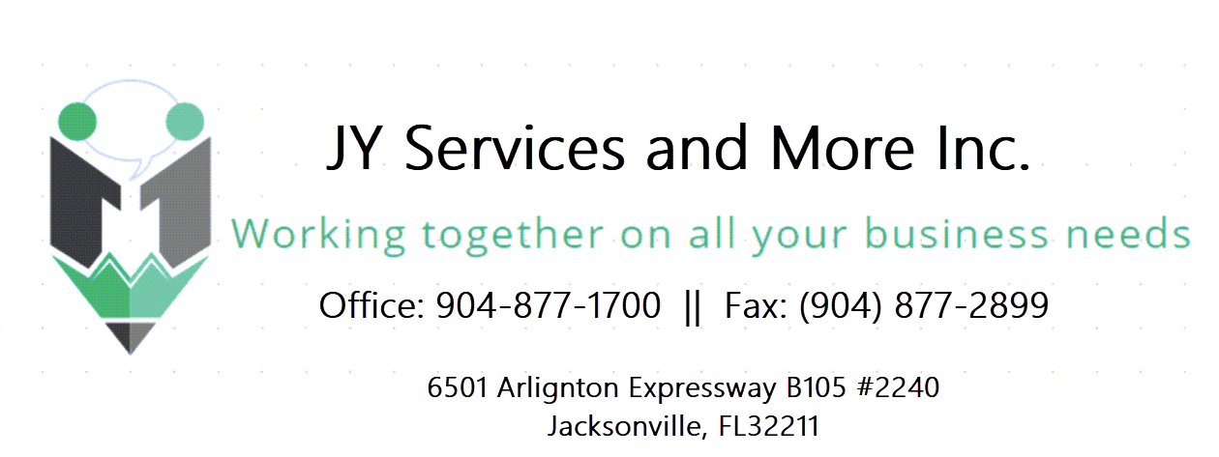
Your New Business
By Desiree Menendez

Slide 2

Business
Entities
Single Member LLC - SCH C - E - F
Limited Liability Company – Limited Responsibility
Multi Member LLC - 1065
Limited Liability Company – Limited Responsibility
CORPORATION -1120
Corporation – Limited Responsibility
The best option for your Business
CORPORATE
NON-CORPORATE
S CORPORATION - 1120-S
Corporation – Limited Responsibility

Slide 3


Commercial Entities
01
Understand the best option for your business
Transmit the knowledge on how each entity taxed and how your business will work
Necesary forms and requirements for a correct tax filing, accounting and tax planning
Development and start-up Project, costs and services
02
03
04

Slide 4
Characteristics
Activity
Single Member LLC
Personal Services
Uber, Cleaning and Gardening
Taxes, Marketing, Legal Services
Easy Handling
Operational Controls
Easy Tax Preparation
Tax filing
Annexes
April 15
Extensions until October 15
Income less than $50,000
SCH C Ordinary Business
SCH F Agroindustry
SCH E Rental Properties
Disadvantages
Taxes
YOUR BUSINESS
Federal
From 10% to 37%
Self-Employment Tax 15.3%
Audit Risks
No Payroll to the owner
Non-constant income
CHARACTRISTICS

Slide 5
Taxation
Home Office
$5 per square feet.
Maximum 300 feet
Annex C / Annex E / Annex F - SMLLC
Self Employment Tax | 15.3% | 12.4% Social (Max. $160,200) 2.9% Medicare (No limit) | Reduce QBI
Non - deductible Expenses | Penalties | Charitable Contributions | Lobbying Expenses
QBI MFJ: $364,200 - $464,200 Everything else: $182,100 - $232,100 | Under elimination range 20% | In the elimination range Aplicable Percentage | Over elimination range $0
Owner | Does not receive payroll | Can have daughters and sons on payroll | Should separate personal from business expenses
Employees | Payroll | 6.2% Social 1.45% Medicare | Half withheld from the employee Half paid by employer
Foreign | Form 1120 header and 5472. | Form 1040-NR if it is connected | Withheld of 37%.

Slide 6
Characteristics
Activity
Multi Member LLC
Guaranteed payments
Operational Agreement
Members
It is governed by the state
Personal Services
Rent, Cleaning, Gardening
Taxes, Marketing, Legal Services, Restaurants
Tax Filing
Forms
1065 y 1120-S: March, 15
Extension to September, 15
1120: April, 15
Extension to October, 15
1065 by default
1120 choosing with 8832
1120-S choosing with 2553
Advantages
Taxes
Flexible taxation
Limited Responsibility
1065: SE Tax 15.3% -
Passes to the partners
1120: Pay 21%
1120-S: Passes to chairholders
YOUR NEW BUSINESS
CHATACTERISTICS

Slide 7
Taxation
LLC / 1065 – Partnership Agreement
Self Employment Tax | 15.3% | 12.4% Social (Max. $160,200) 2.9% Medicare (Without límits) | Reduces QBI
Balance | Income of $250,000 or more | Assests of 1M or more | Requires M-1 y M-2
QBI MFJ: $364,200 - $464,200 Everything else: $182,100 - $232,100 | Under the elimination range 20% | In the elimination range Aplicable percentage | Over the elimination range $0
Owner | Guaranteed Payments | Passive Income | Step Entity
Employees | Payroll | 6.2% Social 1.45% Medicare | Half withheld from the employee Half paid by employer

Slide 8
Characteristics
Corporation C
Activity
Whole Life
Easy transfer
Credibility
Charitable contribution deduction
Personal Services
Rent, Cleaning,,Gardening
Taxes, Marketing, Legal Services , Restaurants
Taxes Filing
Forms
1120
1099-DIV to shareholders
April 15
Extension to October, 15
Disadvantages
Taxes
Double Taxation
No QBI
Incorporation is expensive
YOUR NEW BUSINESS
21% over profits
CHARACTERISTICS

Slide 9
Taxation
1120 – Bylaws
Deductions | Charitable contributions subject to 10% of taxable income | Dividend Income | NOL
Balance | Income of $250,000 or more | Assets of $250,000 or more | M-1 and M-2 Required
Foreign | Owners of more than 25% | Form 5472 | $25,000 Penalty
Owner | Reasonable Compensation (W-2) | Ordinary or qualified dividends | Profit Pay 21%
Employees | Payroll | 6.2% Social 1.45% Medicare | Half withheld from the employee Half paid by employer

Slide 10
Characteristics
Corporation S
Activity
Whole Life
Easy transfer
Credibility
There is no double taxation
Personal Services
Rent, Cleaning, Gardening,
Taxes, Marketing, Legales Services, Restaurants
Tax Filing
Forms
1120-S
K-1 Annexes to shareholders
March,15
Extension to September,15
Disadvantages
Taxes
Expensive Incorporation
Loss of control
Employee Status
YOUR NEW BUSINESS
Passes to the partners
Taxes on built–in profits
CHARACTERISTICS

Slide 11
Taxation
1120-S – Bylaws
Entity | No more than 100 shareholders | Form 2553 | Citizens and residents
Balance | Income of $250,000 or more | Assets of $250,000 or more | M-1 y M-2 Required
QBI MFJ: $364,200 - $464,200 Everything else: $182,100 - $232,100 | Under elimination range 20% | In the elimination range Aplicable percentage | Over the elimination range $0
Owner | Reasonable Compensation (W-2) | Ordinary or qualified dividends | Profits pass to the shareholder
Employees | Payroll | 6.2% Social 1.45% Medicare | Half withheld from the employee Half paid by the employer

Slide 12
S-Corp Election 2553
Elections must be made within the first 75 days of the entity being formed
Rocas LLC
Luxus Inc
Jan 1
Jul 1
 | Jan | Feb | Mar | Apr | May | Jun | Jul | Aug | Sep | Oct | Nov | Dec
Beginning of the Entity
Election 2553 for 2023
Election 2553 para 2024
2023
1
1
17
14
At any time

Slide 13

Employee or Contractor
Employee
Contractor
Audits and Penalties
Meets a schedule, must be paid with W-2
Must fulfill an assignment, without controlling how it is carried out.
A bad classification can generate penalties

Slide 14
Common Law Rules
Behavior
Does the business have control or have the right to control what the employee does and how they perform their job?
Financial Control
The payer controls all business aspects of the employee’s job?
Type of Relationship
Are there written contracts and benefits of the type offered to employees? Will this relationship continue and is the work performed a key aspect of the business?

Slide 15
Economic Reality Test
Is the job an integral part of the hiring company‘s business ?
Is the relationship between the worker and the employer permanent or indifinite?
Does the worker invest in equipment and facilities?
Does the contracting company have the right to control the worker?
Does the worker’s managerial ability affect the opportunity for profit or loss?
Does the job require special skills and initiative?

Slide 16

Strategies to use
Employ daughters and sons
Depending on the entity, you will not have to payroll taxes of you pay then less than $13,850.
Expense Reimbursement
It is used for expenses for meals or trips and or for corporate home offices.
Retirement Plans
They can be set up to save on taxes and save for retirement.

Slide 17
Comparison of entities
Enter the predicted information for each entity.
Compare the amount of taxes to pay
Compare the benefits or disadvantages depending on your case.
Start your business with the best entity for you!

Slide 18
Register the Entity

Slide 19
Thank You
Facebook:
JY Services & More
Contact Number:
904-577-3307
Email Address:
support@jyservicesinc.com

